Slide 1

Full-bar Signal: A Wi-Fi AP Positioning System App
Done by:
Sewar Gharaibeh
Rufaida Altalahmeh
Nagham Al-Zoubi
Aya Al-Antari
Supervised by:
Dr. Ahmad Al-Hammouri
Dr. Fahed Awad
Network Engineering and Security Jordan University of Science and Technology

Slide 2
Outlines
Introduction
Smart WiMAP Tool: A brief history
Smart WiMAP vs Full-bar Signal
Full-bar Signal Application Process
Testing
Throttling
Scanning Test
Full-bar Signal and Smart WiMAP Test
Demonstration
Conclusion

Slide 3

INTRODUCTION
What is Full-Bar Signal?
- Optimal AP locator
- Generates heatmap
- Written in Java
- Supports most Android devices
- Easy steps

Slide 4
Smart wImap: a brief history
Unix-based tool, written in Java
AP locater
Heatmap generation
Rogue AP detection

Slide 5
Smart WiMAP vs Full-bar Signal
 | OS | Tool goal | Scanning Method
Full-bar Signal | Android | Finding the optimal AP location | Active Scanning
SMART WIMAP | Linux | Showing the coverage heatmap | Passive Scanning

Slide 6
Active scanning VS passive scanning
Active scanning :
The device initiates the scan
Advantages
More accurate results
User Control
Disadvantage
Increased power consumption
Increased Network Traffic
Passive scanning:
The device acts like listener
Advantages
Lower power consumption
Faster scan time
Disadvantage
The device needs to be rooted in Android

Slide 7
Full-bar Signal APPLICATION PROCESS
Main Activity
MAP Activity
Heat MAP Activity

Slide 8

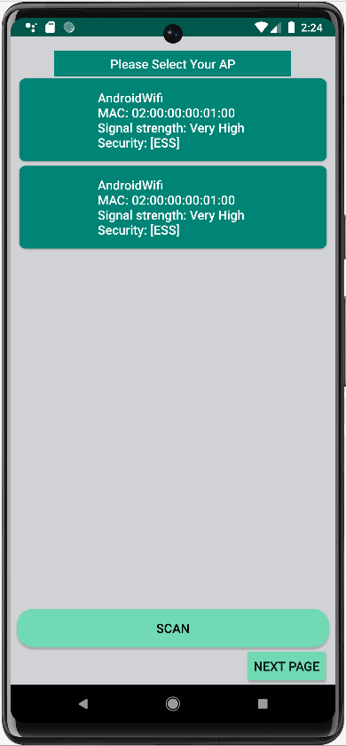
FULL-BAR SIGNAL APPLICATION PROCESS
MAIN ACTIVITY​
Scanning network information​
Choose user's AP​

Slide 9
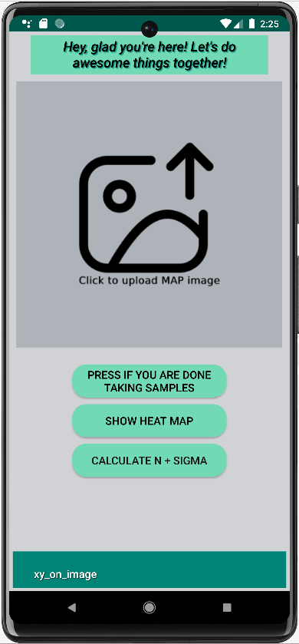
FULL-BAR SIGNAL APPLICATION PROCESS
MAP ACTIVITY
UPLOADING MAP IMAGE
TAKING THE REQUIRED NUMBER OF SAMPLES
CALCULATING ENVIRONMENT CHARACTERISTICS PARAMETERS
N(PATH LOSS EXPONENT) AND SIGMA(SIGNAL VARIATION)
CHOOSE OPTIMAL AP LOCATION BETWEEN GIVEN SUGGESTIONS

Slide 10
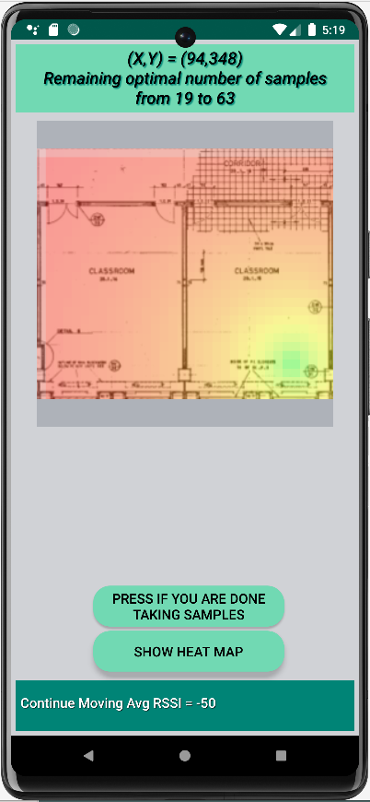
FULL-BAR SIGNAL APPLICATION PROCESS
Heat MAP Activity.
Show heat map for all suggested location.

Slide 11
THROTTLING
It involves restricting the frequency of Wi-Fi scanning to enhance network performance, improve security, and extend battery life.
It is evident that the utilization of throttling results in a higher number of scans conducted and an increased scan rate, as compared to the scenario without throttling.
Below is a table illustrating the contrast in scanning rates when Throttling is enabled and disabled.
Device Type | Android Version | Scanning Time | Total Scans |  | Scan Rate (scan/s)
 |  |  | Throttling ON | Throttling OFF | Throttling ON | Throttling OFF
Samsung Galaxy A53 | 13.0 | 10 minutes | 24 | 186 | 0.02 | 0.31
Samsung Galaxy A7 | 10.0 | 10 minutes | 27 | 452 | 0.04 | 0.75

Slide 12
SCANNING TEST- part1
The table below illustrates the close rates observed across devices within a shared environment when the Throttling option is turned off. Each group of devices represents the testing process conducted in the same environment.
Group # | Device Type | Android Version | Scanning Time | Scan Number | Scan Rate
Group 1 | Samsung A53 time1 | 13 | 10 min = 600 sec | 186 | 0.31/sec
 | Samsung A7(1) time1 | 10 | 10 min = 600 sec | 452 | 0.75/sec
Group 2 | Realme 8 | 12 | 5 min = 300 sec | 1435 | 4.78/sec
 | Samsung S21 | 13 | 10 min = 600 sec | 791 | 1.31/sec
Group 3 | Samsung A52 | 13 | 5 min = 300 sec | 138 | 0.46/sec
 | Samsung S21 | 13 | 5 min = 300 sec | 278 | 0.93/sec
Group 4 | Samsung A31 | 12 | 5 min = 300 sec | 5770 | 19/sec
 | Infinix HOT12 time1 | 12 | 3 min = 180 sec | 2779 | 15.4/sec
 | Infinix HOT12 time2 | 12 | 5 min = 300 sec | 5215 | 17/sec
Group 5 | A7(1) time2 | 10 | 4 min = 240 sec | 168 | 0.7/sec
 | A7(2) time2 | 10 | 4 min = 240 sec | 191 | 0.79/sec

Slide 13
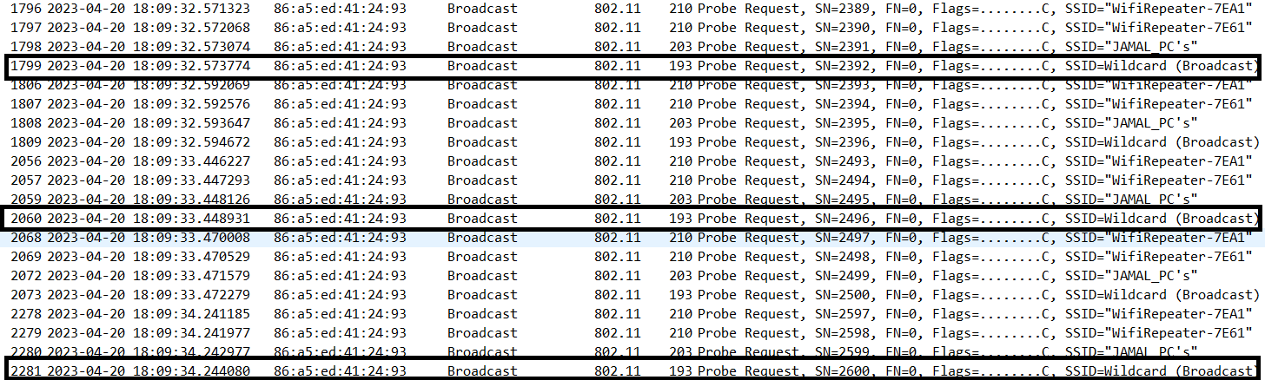
SCANNING TEST- PART2
We tested the same seven devices on one AP in the university library and the scan rate was nearly identical. It ranges from one scan/sec to 1.5 scan/sec.
The investigation on using Wireshark on monitor mode
When testing in monitor mode using (for loop and throttling off) .The time between the probe requests is around one second.

Slide 14
SCANNING TEST- PART2 cont.
And the time between the probe request and reply is around 0.004/sec
We solve this problem (different scan rates) by making the user stand in the same point until we gather the required number of samples.

Slide 15
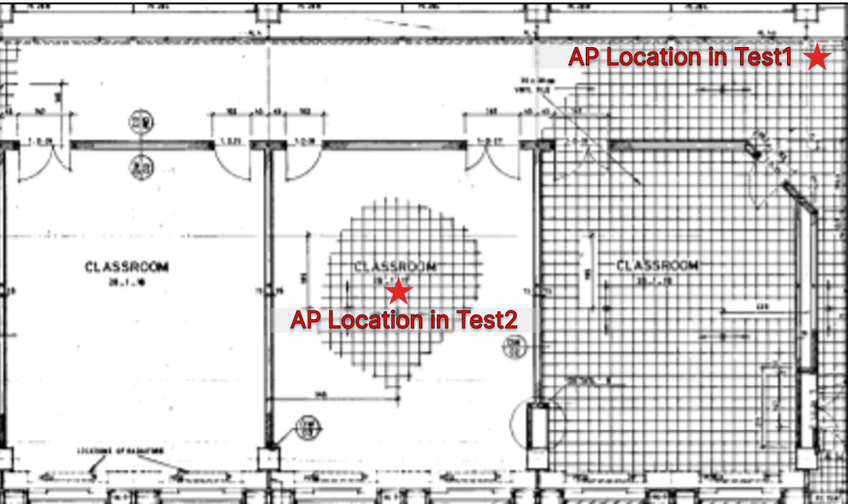
EFFECT OF THE NUMBER OF SAMPLES AND AP PLACEMENT
Test 1
AP Location --> in the corner of the testing area
# of samples --> 19 samples
Result: path loss exponents (n) equal 1.64

Slide 16
EFFECT OF THE NUMBER OF SAMPLES AND AP PLACEMENT cont.
Test 2
AP Location --> at the center
# of samples --> 53 samples
Result: path loss exponents (n) equal 2.27
The expected range of the "n" value in the "Obstructed in building" about 4 to 6.

Slide 17
TESTING RESULTS
Greater accuracy in the Smart-WiMAP due to:
finger thickness
Mouse clicks for selection when selecting two points on the map to enter their real distance in meters, whereas the Full-bar Signal relies on finger taps.
Average RSSI:
Smart-WiMAP tool takes an average of 10 RSSI readings, the full-bar signal application takes the average of only 3 RSSI readings due to its scanning limitation capabilities in active scan.
The outcome of the testing conducted at the CH building within JUST University is as follows:
 | Smart-WiMAP | Full-bar Signal | Error Percentage
Map Scale (meters: pixels) | 1: 88 | 1: 74 | 15.9 %
Path Loss Exponent (n) | 2.53 | 2.32 | 8.3 %

Slide 18
DEMo

Slide 19

Conclusion - Future Work
Full-bar Signal mobile application:
Incorporate INS (Inertial Navigation System) for improved indoor positioning.
Add zoom in and out functionality to enhance map viewing options.
Enhance the user interface for improved usability.
Develop the ability to find optimal locations for multiple access points (APs).

Slide 20

THANK YOU!

